Slide 1

Performance Analysis of Heterogenous Computing Architectures
Members:
Ravi Teja Anumula
Sairam Kanchusthambham
Sri Sudha
Shiva Jyothi

Slide 2
Proposal description
With an emphasis on both performance and energy efficiency, this research intends to use the gem5 simulator to conduct a thorough investigation of heterogeneous computing architectures. We will examine the following crucial areas by modelling a system with a CPU and one or more accelerator components.

Slide 3

Comment
“Seems reasonable! You can start working on the project”

Slide 4
Work done
We have done initial research on different accelerator components and decided to proceed with GPU.
We have searched for the ways to implement to CPU-GPU heterogenous systems like GEM5-GPU, CUDA, OPENCL and their supports with other extensions.
GEM5-GPU has become obsolete after the addition of native AMD GPU within Gem5 and the installation is no longer working properly, so we decide to work on other implementations.

Slide 5

Work done
Native AMD GPU works for implementing Standalone GPU projects but needs a lot of roundabouts to use heterogenous systems.
We also tried to use Accelergy and Timeloop extensions but faced challenges on integrating them with gem5.

Slide 6
Changes to the Original proposal
We have decided to work solely on the Performance Analysis as the extensions needed for Energy analysis needs a lot of customizations.
We have implemented performance analysis on CPU, GPU and CPU-GPU systems using Matrix multiplication and Matrix addition.
We have used GEM5 for CPU and CUDA for GPU and CPU-GPU simulations.

Slide 7
Progress Comments
“Interesting update, would like to see the final report to understand how well it is.”

Slide 8
Work done after progress report
We have installed Native AMD GPU on Gem5 and tried to used it to compute Heterogenous CPU-GPU systems on GEM5.
We have done performance Analysis of Matrix Multiplication and Matrix Addition on CPU using Gem5.
We have done performance Analysis of Matrix Multiplication and Matrix Addition on GPU using CUDA.
We have done performance Analysis of Matrix Multiplication and Matrix Addition on CPU-GPU heterogenous system using CUDA.

Slide 9
Performance Analysis of CPU using GEM5

Slide 10
Gem5 overview:
Introduction to Gem5
What is Gem5?
Gem5 is an open-source simulator that allows researchers to explore and evaluate computer architectures.
It provides cycle-accurate modeling, enabling detailed analysis of system performance.
Significance in Computer Architecture Research
Research Tool:
Gem5 is widely used in academia and industry for studying computer architecture and microarchitecture.
It facilitates experimentation with different CPU models, memory hierarchies, and system configurations.
Capabilities for CPU Architecture Simulation
Cycle-Accurate Simulation:
Gem5 is capable of simulating CPU architectures at the cycle level, providing high granularity.
This enables accurate analysis of how each instruction impacts system performance.

Slide 11
Gem5 overview:
Diverse CPU Architectures
Versatility:
Gem5 supports a range of CPU architectures, including ARM, x86, and others.
Researchers can use Gem5 to model and analyze various CPU designs.
Simulation Flexibility
Configurability:
Researchers can configure Gem5 to simulate different aspects of a computing system, such as memory hierarchies, caches, and interconnects.
This flexibility makes it suitable for a broad spectrum of experiments.

Slide 12
Matrix Multiplication Algorithm
Overview of Matrix Multiplication
Algorithm Recap:
Matrix multiplication involves the computation of each element in the resulting matrix by summing products of corresponding elements from two input matrices.
The standard algorithm has a cubic time complexity (O(N^3)).
Computational Complexity
Resource Requirements:
Matrix multiplication is computationally expensive, especially for large matrices.
Discuss the challenges posed by the algorithm's high computational complexity.

Slide 13
Matrix Multiplication:
#include <stdio.h>
#include <time.h> // Include to measure execution time
#define NRA 16 /* number of rows in matrix A */
#define NCA 16 /* number of columns in matrix A */
#define NRB 16 /* number of rows in matrix B, should equal to NCA */
#define NCB 16 /* number of columns in matrix B */
int main (int argc, char *argv[])
{
int i, j, k; /* loop indices */
int A[NRA][NCA], /* matrix A to be multiplied */
B[NRB][NCB], /* matrix B to be multiplied */
C[NRA][NCB]; /* result matrix C */
// Variable to store the execution time
clock_t start, end;
double cpu_time_used;
// Start measuring time
start = clock();
// Do some basic error checking
if (NRB != NCA) {
printf ("Matrix A column size must equal matrix B row size.\n");
return 1;
}
printf("Matrix A: #rows %d; #cols %d\n", NRA, NCA);
printf("Matrix B: #rows %d; #cols %d\n", NRB, NCB);
printf ("\n");

Slide 14
Matrix Multiplication
printf("Initializing arrays...\n");
// Initialize matrices A and B
for (i = 0; i < NRA; i++)
for (j = 0; j < NCA; j++)
A[i][j] = i + j;
for (i = 0; i < NRB; i++)
for (j = 0; j < NCB; j++)
B[i][j] = i - j;
// Perform matrix multiplication to populate matrix C
for (i = 0; i < NRA; i++)
for (j = 0; j < NCB; j++) {
C[i][j] = 0;
for (k = 0; k < NCA; k++)
C[i][j] += A[i][k] * B[k][j];
}
// End measuring time
end = clock();
cpu_time_used = ((double) (end - start)) / CLOCKS_PER_SEC; // in seconds
// Print result matrix C
printf("Result Matrix:\n");
for (i = 0; i < NRA; i++) {
for (j = 0; j < NCB; j++)
printf("%d\t", C[i][j]);
printf("\n");
}
// Print the execution time
printf("\nExecution Time: %f milliseconds\n", cpu_time_used * 1000);
return 0;
}

Slide 15
GEM5 Setup & WorkFlow
Gem5 Configuration
Simulation Parameters:
We have analyzed the performance by varying different CPU models like X86Minor, 03CPU, X86AtomicSimpleCPU, X86TimingSimpleCPU
We have also varied the matrix size as 4x4, 8x8, and 16x16 and recorded their execution time for each CPU.
We have also included a Execution time measurement code within matmult code to find the execution time.
Matrix Initialization:
Input matrices are initialized with appropriate values before the simulation.
Execution:
Gem5 simulates the matrix multiplication algorithm, tracking each instruction's execution.
Data Collection:
Relevant performance metrics, such as IPC (Instructions Per Cycle), cycle count, and cache statistics, are collected during the simulation.

Slide 16
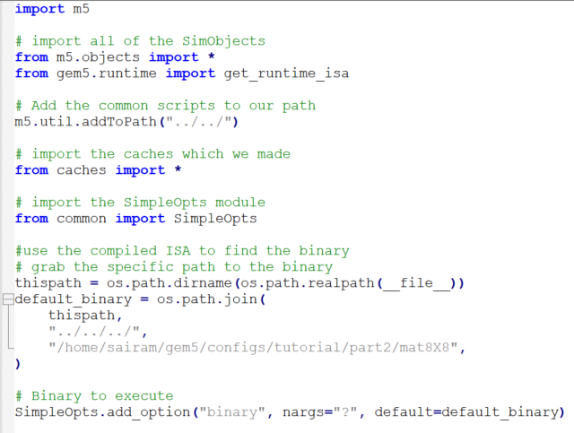
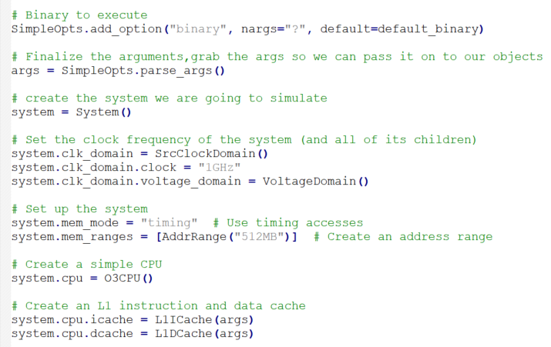
GEM5 Configuration:

Slide 17
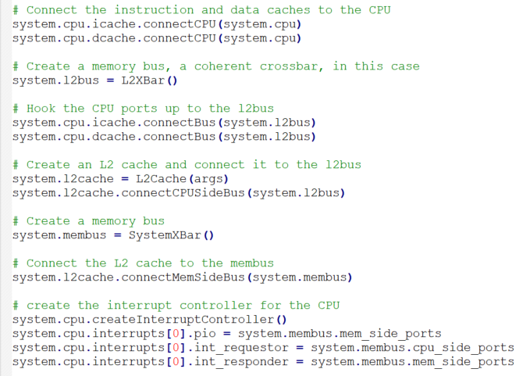
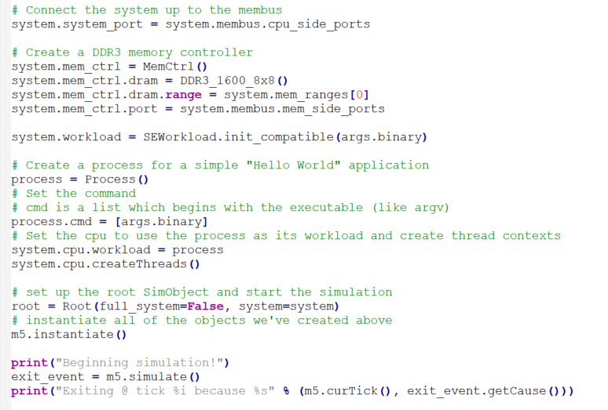
GEM5 Configuration:

Slide 18
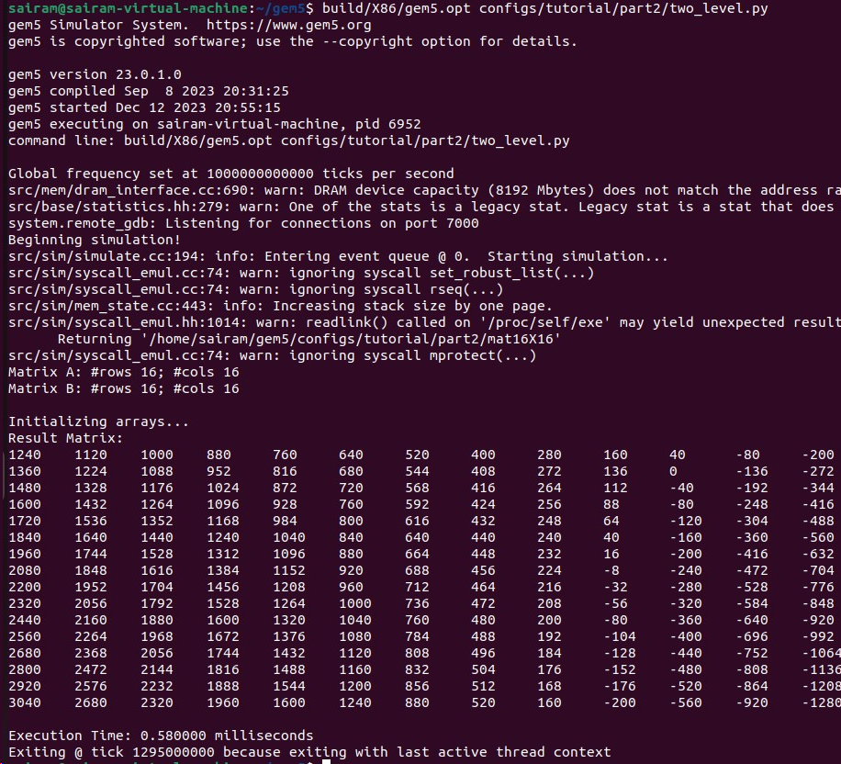
Output and Inference:
The outputs for each case of different CPU and different Matrix sizes are obtained after each computation and they are compared to find the optimal execution parameters.

Slide 19
Comparison:
Matrix Addition
Matrix Multiplication

Slide 20
Performance Analysis of GPU using CUDA

Slide 21
GPU Computation Overview:
Graphical Processing Units:
Originally designed for rendering graphics.
Evolved into a parallel processing powerhouse for general-purpose computing.
Parallel Processing Model
Thousands of Cores:
Unlike CPUs with a few powerful cores, GPUs have thousands of smaller cores.
Each core is capable of performing its own set of instructions simultaneously.
SIMD Architecture:
Single Instruction, Multiple Data (SIMD) architecture.
Allows execution of the same instruction on multiple data elements in parallel.
CUDA Cores
CUDA Cores:
Basic processing units in NVIDIA GPUs.
Execute instructions independently, allowing for parallelism.
Streaming Multiprocessors (SMs):
Groups of CUDA cores organized into streaming multiprocessors.
Handle parallel execution of threads in a coordinated manner.

Slide 22
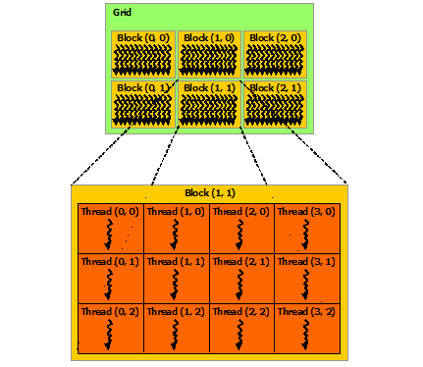
GPU Overview:
Threads and Thread Blocks
Threads:
Basic unit of execution in a GPU.
Thousands to millions of threads can run concurrently.
Thread Blocks:
Threads are organized into thread blocks.
Threads within a block can communicate and synchronize with each other.
Grids and Blocks
Grids:
Organize thread blocks into a grid.
Grids are the highest level of organization in CUDA.
Blocks:
A grid is comprised of multiple thread blocks.
Blocks are the units of work scheduled on a streaming multiprocessor.

Slide 23
Programming for GPU:
CUDA Toolkit:
Software development kit for programming NVIDIA GPUs.
Provides libraries, compilers, and development tools for CUDA programming.
Overview of CUDA Programming Model
Parallelism Model:
CUDA follows a SIMT (Single Instruction, Multiple Threads) parallelism model.
Threads execute the same program but on different data.
Kernels:
Kernels are functions that run on the GPU.
Invoked by the host (CPU) and executed in parallel by multiple threads on the GPU.
It is defined using “__global__” keyword in CUDA C.
Thread Hierarchy:
Threads are organized into 1D, 2D, or 3D grids.
Each grid is comprised of thread blocks, and each block contains multiple threads.

Slide 24
Programming for GPU:
Importance of Thread Synchronization in Parallel Computing
Thread Synchronization:
Proper synchronization is crucial to avoid race conditions and ensure correct results.
CUDA provides synchronization mechanisms such as barriers (__syncthreads()) within a block.
Coordinated Execution:
Threads within a block often cooperate to perform a task, requiring synchronization points.
Synchronization ensures that threads complete their tasks before moving to the next phase.
Data Sharing:
Shared memory is a crucial resource for data sharing among threads in the same block.
Synchronization mechanisms help manage concurrent access to shared data.

Slide 25
CUDA Implementation:
#include <stdio.h>
#include <stdlib.h>
#include <cuda_runtime.h>
#define SIZE 16
// Matrix multiplication kernel
__global__ void matrixMul(int* a, int* b, int* c, int width) {
int row = blockIdx.y * blockDim.y + threadIdx.y;
int col = blockIdx.x * blockDim.x + threadIdx.x;
if (row < width && col < width) {
int sum = 0;
for (int k = 0; k < width; ++k) {
sum += a[row * width + k] * b[k * width + col];
}
c[row * width + col] = sum;
}
calculates the global row index.
calculates the global column index.

Slide 26
CUDA Implementation :
int main() {
int blockSizeValues[] = { 4, 8, 16 }; // Different block sizes to test
int num_blockSizes = sizeof(blockSizeValues) / sizeof(blockSizeValues[0]);
int gridSizeValues[] = { 2, 4, 8 }; // Different grid sizes to test
int num_gridSizes = sizeof(gridSizeValues) / sizeof(gridSizeValues[0]);
for (int b = 0; b < num_blockSizes; ++b) {
int blockSize = blockSizeValues[b];
for (int g = 0; g < num_gridSizes; ++g) {
int gridSize = gridSizeValues[g];
int size = SIZE;
int matrixSize = size * size * sizeof(int);
// Host matrices
int* h_A, * h_B, * h_C;
h_A = (int*)malloc(matrixSize);
h_B = (int*)malloc(matrixSize);
h_C = (int*)malloc(matrixSize);
// Initialize matrices
for (int i = 0; i < size * size; ++i) {
h_A[i] = 1;
h_B[i] = 2;
h_C[i] = 0;
}
// Device matrices
int* d_A, * d_B, * d_C;
cudaMalloc((void**)&d_A, matrixSize);
cudaMalloc((void**)&d_B, matrixSize);
cudaMalloc((void**)&d_C, matrixSize);
// Copy host matrices to device
cudaMemcpy(d_A, h_A, matrixSize, cudaMemcpyHostToDevice);
cudaMemcpy(d_B, h_B, matrixSize, cudaMemcpyHostToDevice);

Slide 27
CUDA Implementation:
// Set the block size and grid size
dim3 blockSizeDim(blockSize, blockSize);
dim3 gridSizeDim(gridSize, gridSize);
// Use CUDA events for timing
cudaEvent_t start, stop;
cudaEventCreate(&start);
cudaEventCreate(&stop);
// Record start event
cudaEventRecord(start, 0);
// Launch the matrix multiplication kernel
matrixMul << <gridSizeDim, blockSizeDim >> > (d_A, d_B, d_C, size);
// Record stop event
cudaEventRecord(stop, 0);
cudaEventSynchronize(stop);
// Copy the result back to the host
cudaMemcpy(h_C, d_C, matrixSize, cudaMemcpyDeviceToHost);
// Calculate elapsed time
float elapsedTime;
cudaEventElapsedTime(&elapsedTime, start, stop);
printf("Matrix Size: %dx%d, Block Size: %dx%d, Grid Size: %dx%d, Execution Time: %f ms\n", size, size, blockSizeDim.x, blockSizeDim.y, gridSizeDim.x, gridSizeDim.y, elapsedTime);
// Free device memory
cudaFree(d_A); cudaFree(d_B); cudaFree(d_C);
// Free host memory
free(h_A); free(h_B); free(h_C);
// Destroy events
cudaEventDestroy(start);
cudaEventDestroy(stop);
}
}
return 0;}

Slide 28
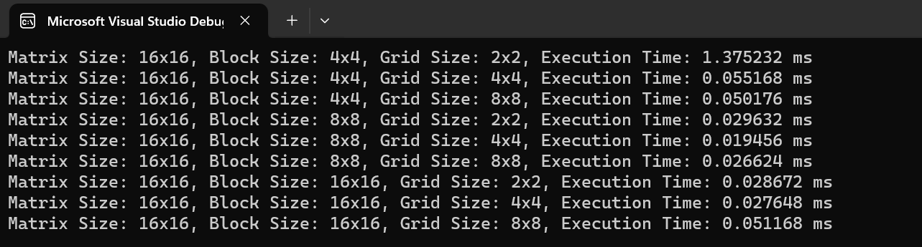
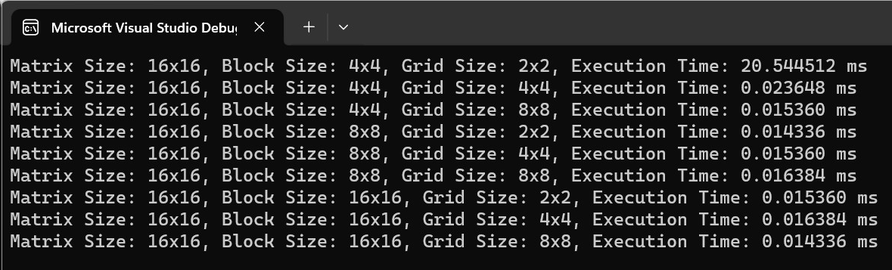
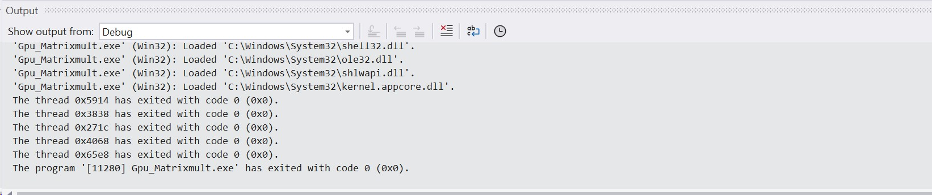
Outputs and Inference:
Matrix Multiplication
Matrix Addition
After implementing the code on CUDA using Visual Studio, We can infer from the output that the Execution time is different for different Block size and Grid size.
The execution time decreases upon using higher block size or grid size.
Threads Used

Slide 29
Comparison
Matrix Multiplication
Matrix Addition

Slide 30
Performance Analysis of CPU-GPU heterogenous Computing Architecture using CUDA

Slide 31
Heterogenous Computing Overview:
Introduction
Definition:
Heterogeneous computing involves the integration of different types of processors or cores, typically combining CPUs and GPUs.
Parallel Processing:
CPUs excel at general-purpose tasks and sequential processing.
GPUs are specialized for parallel processing with thousands of cores.
Advantages of Heterogeneous Computing
Parallelism:
GPU's ability to handle parallel tasks complements CPU's sequential processing.
Performance Boost:
Leveraging both CPU and GPU strengths can result in significant performance improvements.
Task Offloading:
Assigning suitable tasks to the CPU or GPU based on their specific capabilities.
Use Cases
Graphics and Simulation:
GPU for rendering and simulations.
Data Science:
CPU for data preprocessing, GPU for parallelized machine learning tasks.
Scientific Computing:
Hybrid architectures for complex simulations and computations.

Slide 32
GPU and CPU characteristics:
1. GPU Characteristics
Parallelism:
Thousands of cores capable of simultaneous processing.
Memory Bandwidth:
High bandwidth suitable for parallel data access.
Specialized Tasks:
Graphics rendering, parallel computations (e.g., matrix multiplication).
2. CPU Characteristics
Serial Processing:
Fewer cores optimized for sequential processing.
Cache Memory:
Smaller but faster memory caches.
General-Purpose:
Versatility for a wide range of tasks.
3. Complementary Nature
Parallel-Sequential Collaboration:
GPUs handle parallel tasks, CPUs handle sequential tasks.
Task Allocation:
Capitalizing on the strengths of each processor for optimal performance.

Slide 33
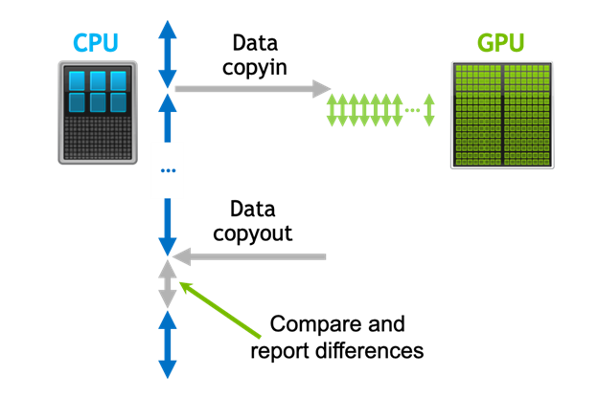
CUDA Implementation:
We have used code similiar to the one used in GPU analysis but instead of changing the block size and grid size we have changed the Matrix sizes and also include the code so that same multiplication is executed in CPU as well.
Here, the input is given from the CPU (Host in this case) and this data is sent to the GPU (Device in this case).
The Device starts implementing the matrix multiplication using parallel computing from the data acquired from the Host and after computation sends the data back to the host.
Meanwhile, the Host also performs the computation sequentially and generates output. After receiving the result from Device (GPU), both the results are checked and if they match, the output is generated along with their execution time.

Slide 34
Additional code used:
// Function to perform matrix multiplication on CPU
void matrixMulCPU(int* A, int* B, int* C, int N) {
for (int i = 0; i < N; ++i) {
for (int j = 0; j < N; ++j) {
int sum = 0;
for (int k = 0; k < N; ++k) {
sum += A[i * N + k] * B[k * N + j];
}
C[i * N + j] = sum;
}
}
}
// Measure CPU execution time
auto startCPU = std::chrono::high_resolution_clock::now();
for (int iter = 0; iter < numIterations; ++iter) {
// Perform matrix multiplication on CPU for comparison
matrixMulCPU(h_A, h_B, h_C_CPU, currentSize);
}
auto endCPU = std::chrono::high_resolution_clock::now();
auto durationCPU = std::chrono::duration_cast<std::chrono::microseconds>(endCPU - startCPU) / numIterations;
// Verify the result
for (int i = 0; i < currentSize * currentSize; ++i) {
if (h_C_GPU[i] != h_C_CPU[i]) {
std::cerr << "Verification failed at index " << i << " for matrix size " << currentSize << "\n";
break;
}
}

Slide 35
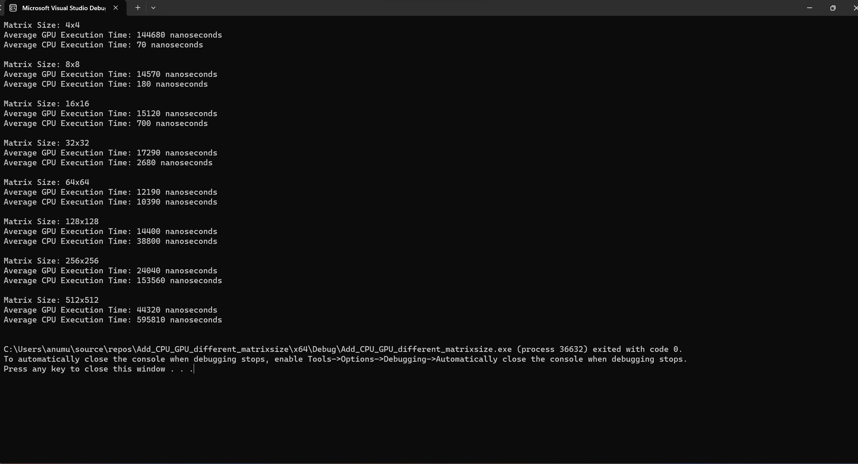
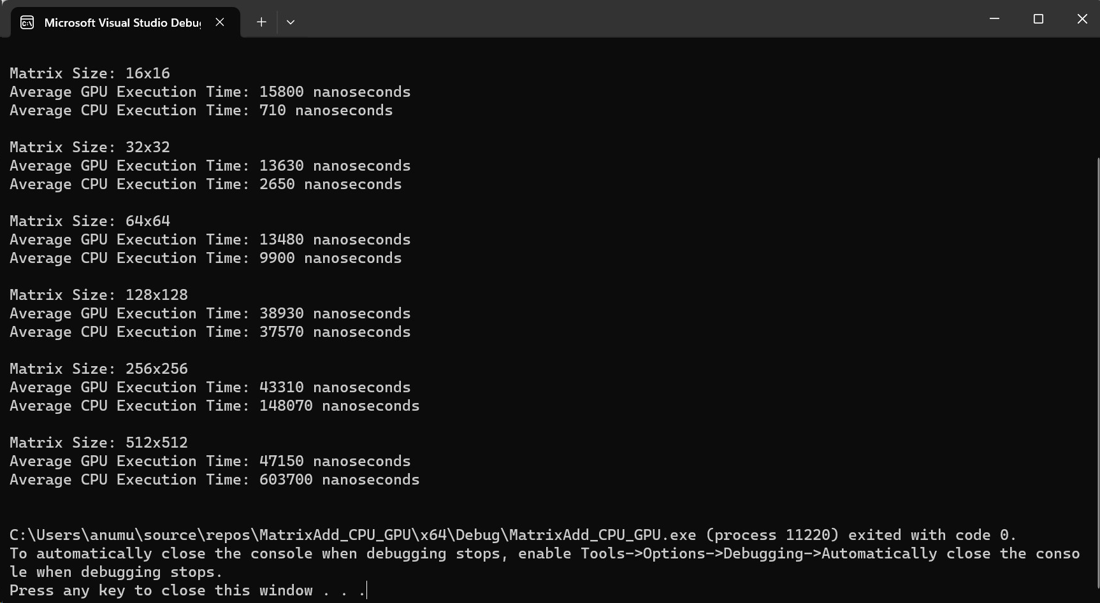
Outputs and Inference:
Matrix Multiplication
Matrix Addition
From the implementation, we can see that the execution time of matrix multiplication of both CPU and GPU differ with respect to matrix size.
We can observe that the GPU execution is better than CPU only when matrix size increases to 128.
This is because the parallel computation done in matrix mult only shows its effect at larger sizes.
The speed of cores is higher in CPU compared to GPU so they are faster in smaller sizes and as size increase parallel computation shows its effect.

Slide 36
Comparision
Matrix Multiplication
Matrix Addition

Slide 37

Future Scope
From the work done till now, We establish a relation between different aspects like CPU model, GPU Model, kernel, block size, grid size, Matrix size with the execution speed of matrix multiplication.
Upon using this details, we can select the conditions required for optimal execution speed while performing the Heterogenous computing where both CPU and GPU work together in executing the tasks like Matrix Multiplication.
This work is to be done using OpenCL which is a standard tool for heterogenous architecture.

